Slide 1
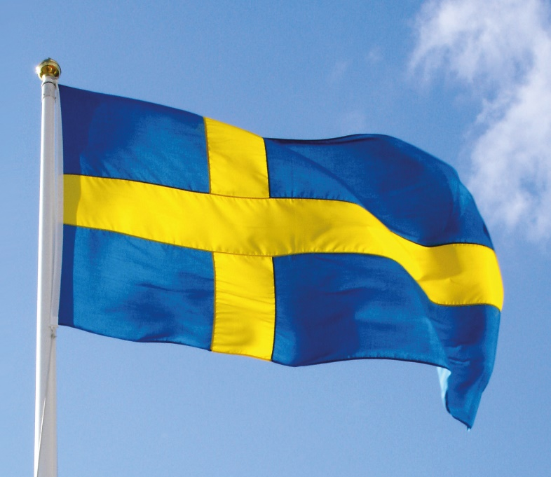
Järfällagymnasterna
Sweden

Slide 2
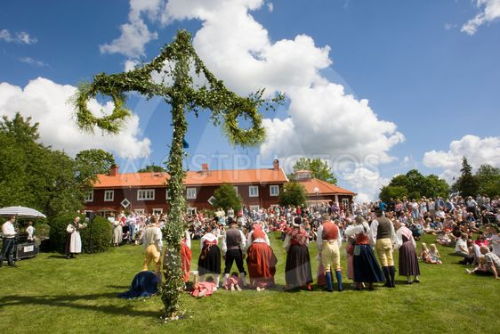
SWEDEN – a sporting nation
Approximately 10 million inhabitants
More than 3 million are members in a sports club
Some 2,4 million are ACTIVE in a sports club
Swedish sport focuses particularly on youth sport and sport for all
Half a million coaches of whom the majority are volunteers
Our voluntary coaches are cruical for our day-to-day activities

Slide 3
The idea of Sport in Sweden
”We are involved in non-profit sports clubs to
have fun, feel good and develop throughout life”
Sport for all, through-out life is the main focus for sports in Sweden.
73% of sport clubs organise sport-for-all for adults
86% of sport clubs have activities for children and young people
less than one in four sports clubs have activites for elite sport

Slide 4
Sport in a sports club
Voluntary societies play a major role in Swedish life. We have the highest ratio of societies and clubs to population in the world.
There are around 20 000 sports clubs in Sweden
Almost two in three boys and one in two girls between the ages of 6 and 18 are members of a sports club

Slide 5
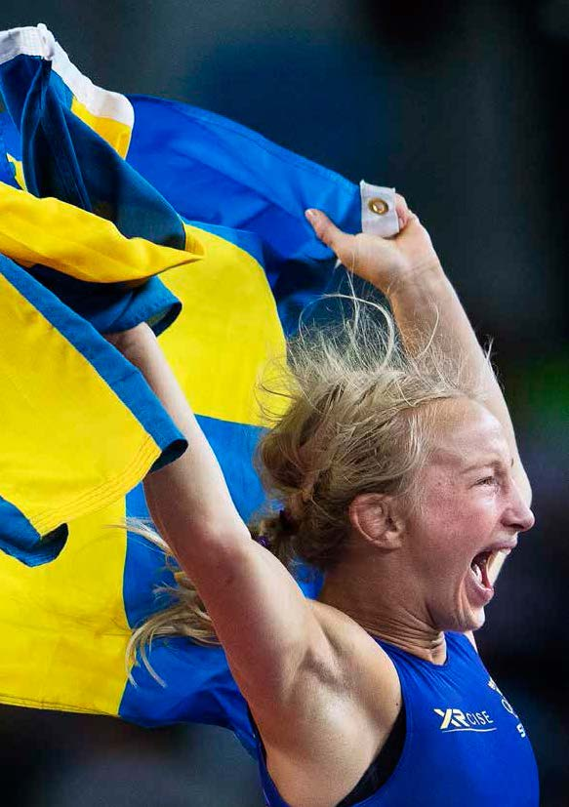
Characteristics of the Swedish sports movement
Open for all
Independent
Nonprofit
Democratic
Based on voluntary leadership and work
A co-operating force in developing society
Support from government and society

Slide 6
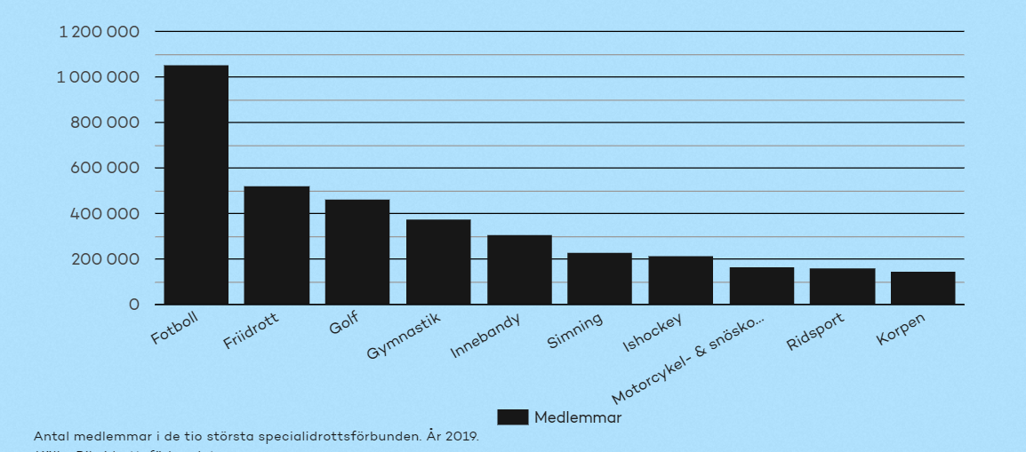
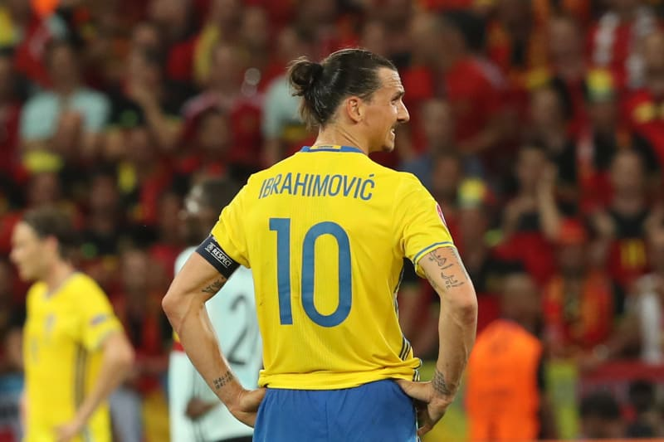
The ten largest sports in Sweden 2019
Notes:
Sweden was considered in 2017 to be the fifth best per capita country in the world and world-leading in two sports, bandy and orienteering.

Slide 7
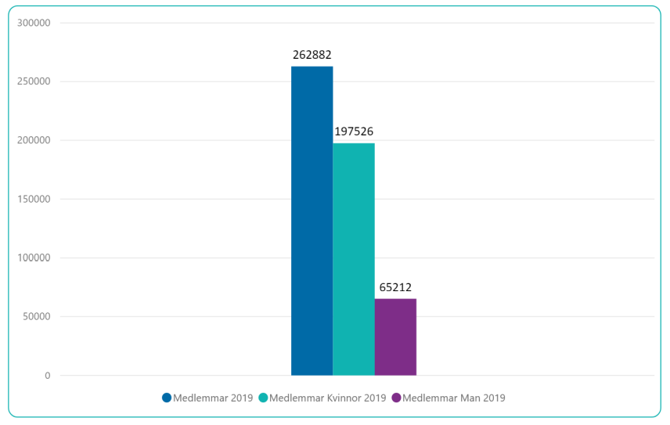
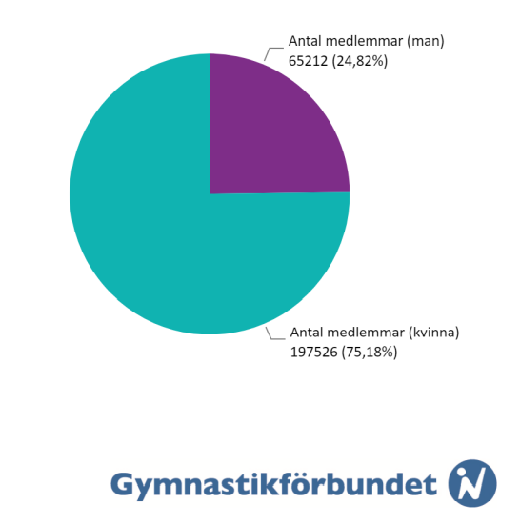
Members of the Swedish Gymnastics Federation 2019
Blue: Members total
Green: Female (75 %)
Purple: Male (25 %)

Slide 8
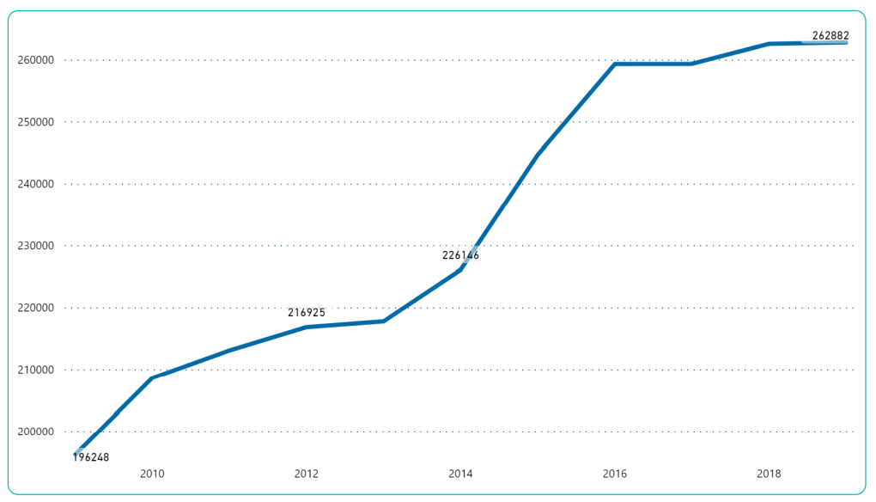
Members of Swedish Gymnastics Federation
Development 2009-2019

Slide 9
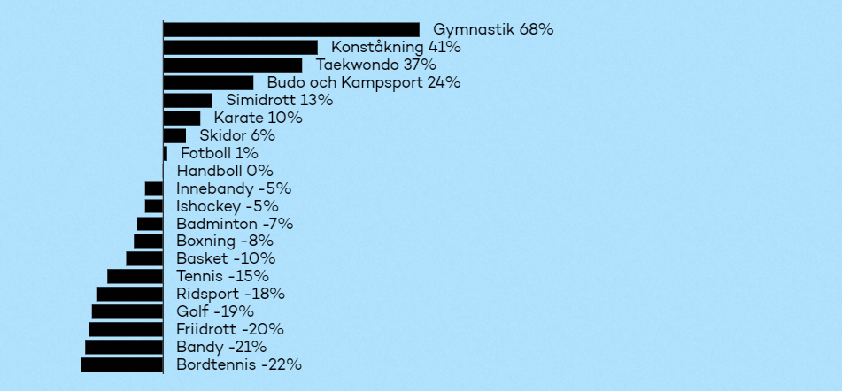
Development of members per sport in the 20 largest sports 2010-2018 Gymnastics is growing more than anyone!

Slide 10
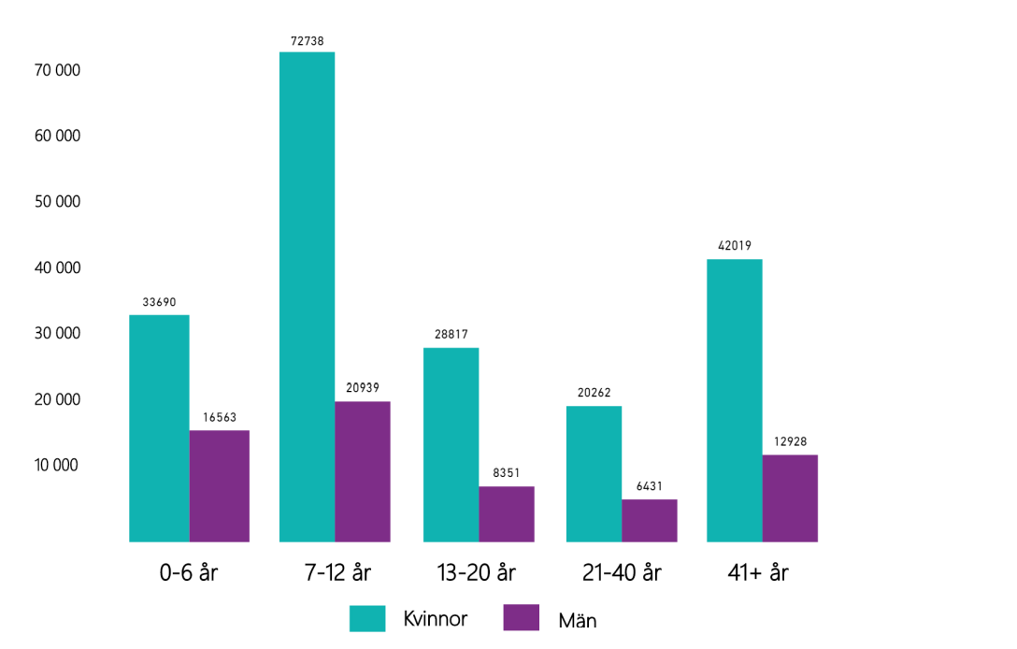
Members, age and gender 2019

Slide 11
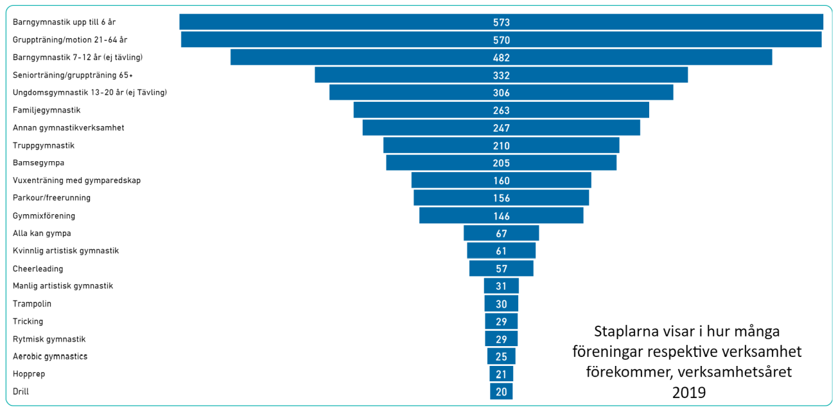
Number of Swedish clubs offering different disciplines 2019

Slide 12
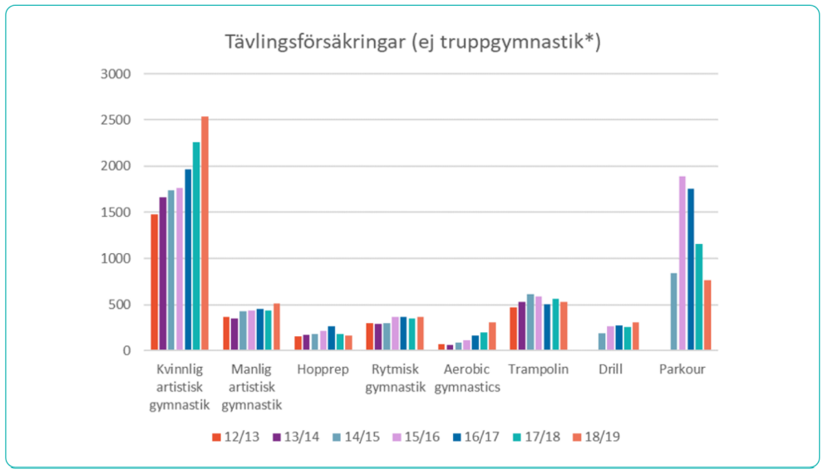
Number of gymnasts competing each discipline

Slide 13
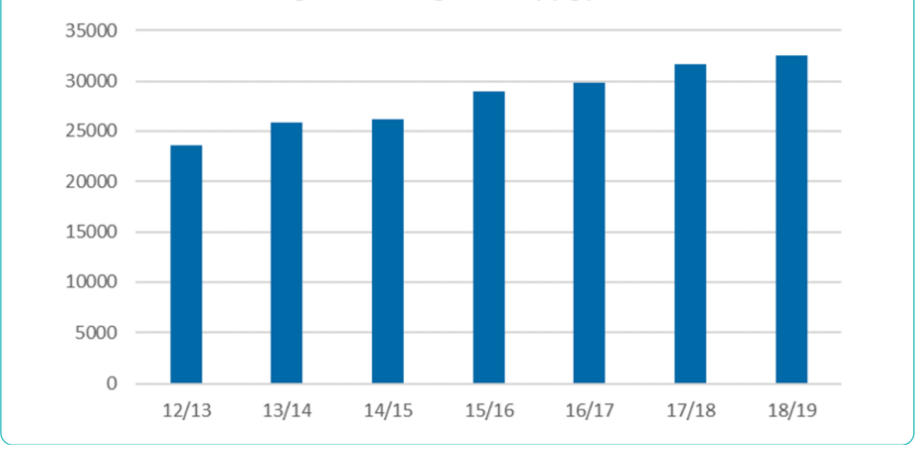
Teamgym – number of gymnasts competing

Slide 14
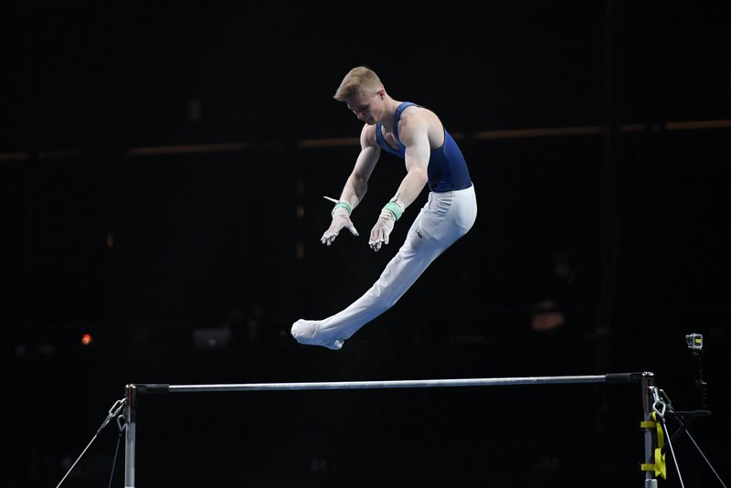
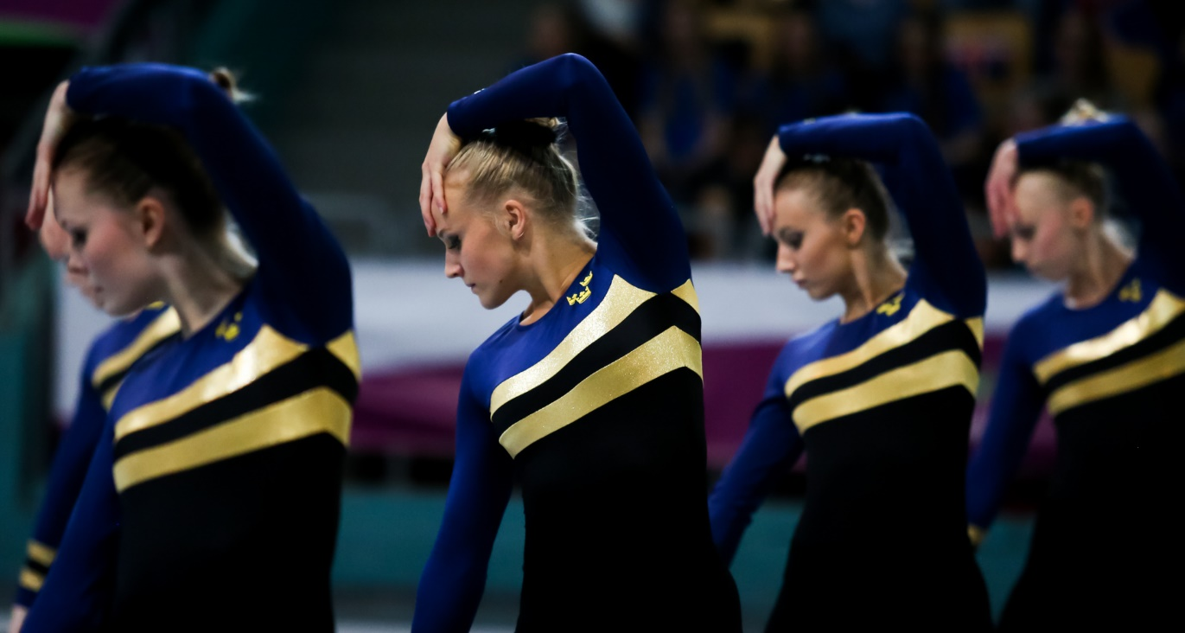
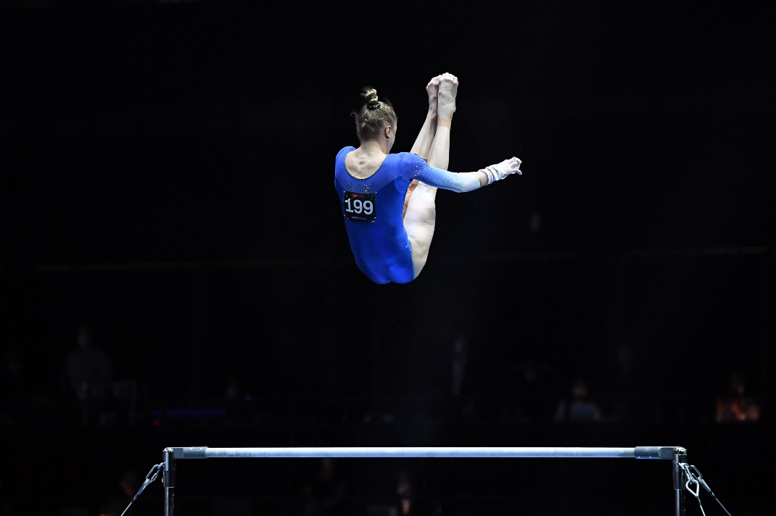
Top results European Championships
WAG 2021
Tonya Paulsson: Allaround final 14th
Jonna Adlerteg: Bars final: 6th
MAG 2021
David Rumbutis: Allaround final 13th
Teamgym (postponed 2020, results from 2018)
Women: 1st - Gold Men: 2nd - Silver Mixed: 1st - Gold

Slide 15
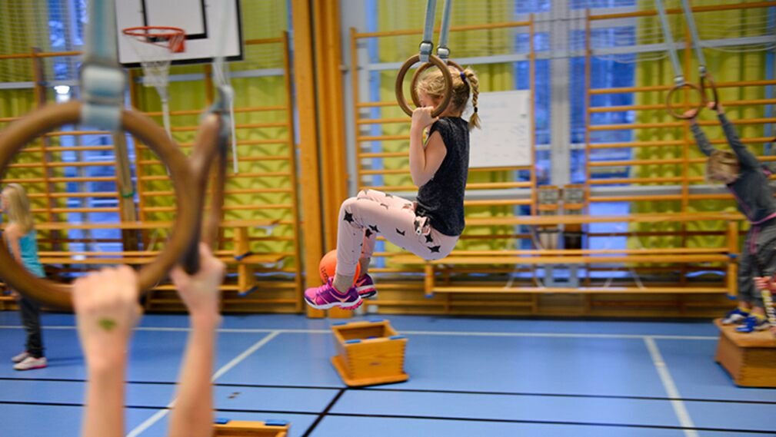
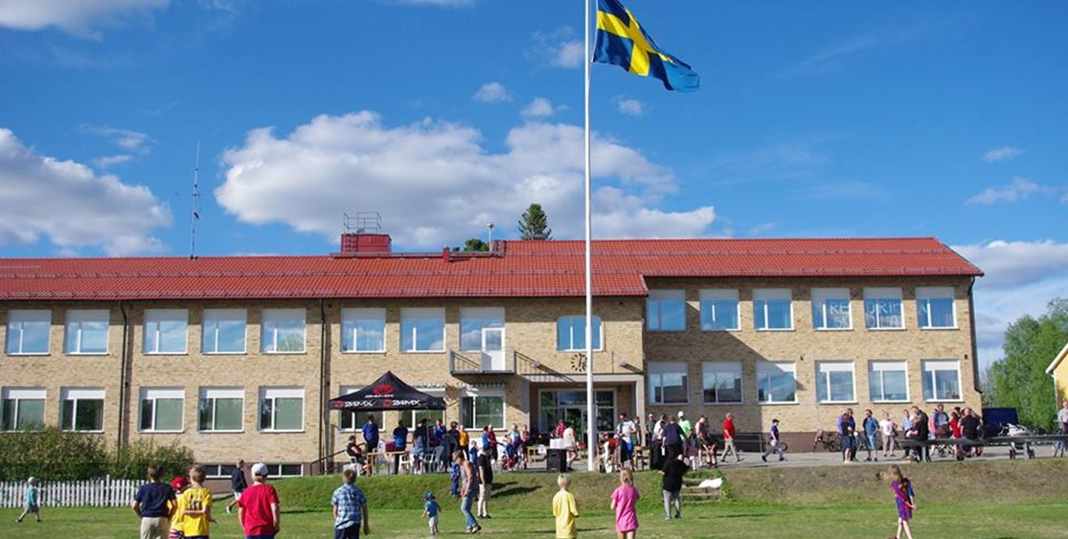
Sports / Physical Education in schools
Schools have educated Physical Education teachers for students from
7 years old and up
7-9 years old: total of 140 hours PE (1 lesson per week on average)
10-12 years old: total of 180 hours PE (1-2 lessons per week on average)
13-15 years old: total of 280 hours PE (2 lessons per week)
16-18 years old: total of 100-200 hours PE (1 lesson per week for 1-2 of 3 years on average)
Teenagers tend to quit sports, so the government added more PE in 2020 – from 500 hours in total (7-15 years) to 600 hours, all of the 100 extra hours was added for ages 12-15.
Järfällagymnasterna rents school gyms for recreational
gymnastics (JG-hallen is full!)
Preschools and schools in Järfälla can train in JG-hallen
during daytime.

Slide 16
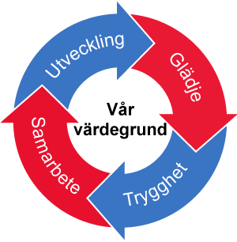
Järfällagymnasterna
Values: Joy, Safe sport, Cooperation, Development
Situated in Järfälla, north of Stockholm
Nonprofit club started in 1976
Approximately 1300 members
Arrange two national teamgym competitions per year, crucial for finances.
Since 2006, we have our own facility of 2500 m2, JG-hallen. Also train in twelve school sports facilities within Järfälla.
Recreational gymnasts: 643
Teamgym gymnasts: 257
WAG gymnasts: 62
Aerobic gymnastics gymnasts: 21
Parkour: 18
Gymnastics for all, with disabilities: 10

Slide 17
This is Järfällagymnasterna
Teamgym
Gymnastics for all – kids with disabilities
Recreational gymnastics for kids, teens and adults
Parkour
Aerobic gymnastics
Womens Artistic Gymnastics

Slide 18
Gymnastics for all
Alla kan gympa =
Everyone can do gymnastics!
For kids with disabilites like Downs syndrome.
Kids with ADHD and other neurophysical diagnoses are included in regular classes.

Slide 19
Coaches in Järfällagymnasterna
Voluntary coaches: 250
Hired coaches: 1 full time teamgym coach, hiring a full time WAG/recreational coach now
Administration and facililties: 2 full time
Voluntary coaches get paid per hour, based on years of experience and completed education from the Gymnastics federation. Paid out twice a year (summer and Christmas). Most voluntary coaches are parents or former/current gymnasts (teenagers and up).
We check police records since 2017 (mandatory in Sweden since 2020)
TREND: Harder and harder to get parents to be voluntary coaches. More reliant on hired coaches and gymnasts.

Slide 20
Most important factors to keep many kids in the sport
Many gymnasts leave the sport as early as 11 years old.
Keep it fun!
Educated coaches
Safe environment, friendships and team spirit
Let the kids decide how many hours they train and if they want to compete. Flexible when schools take more time (reduces hours)
Going from selecting ”talented” small children for competetive gymnastics to focusing on the childs own goals and drive.
”99 % never reach elite level, so let´s focus on them most.”
Many types of training – you can move from recreational to competitive and back, move from WAG to Teamgym etc.

Slide 21
Thank you for listening!
Marie Darsenius Obert
marie@jarfallagymnasterna.se

